Slide 1


NEXT GENERATION LIPIDS,
REDEFINED WITH PURPOSE
Naturmega Introduction

Slide 2
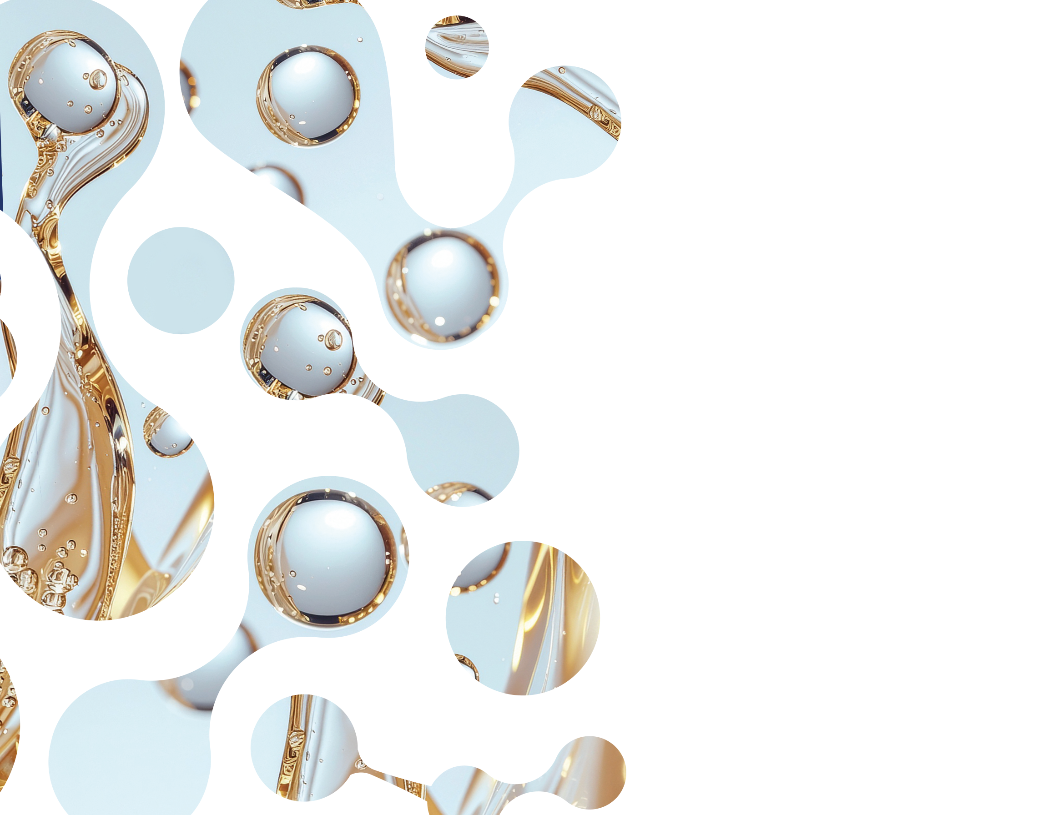
Naturmega
At a Glance

Slide 3
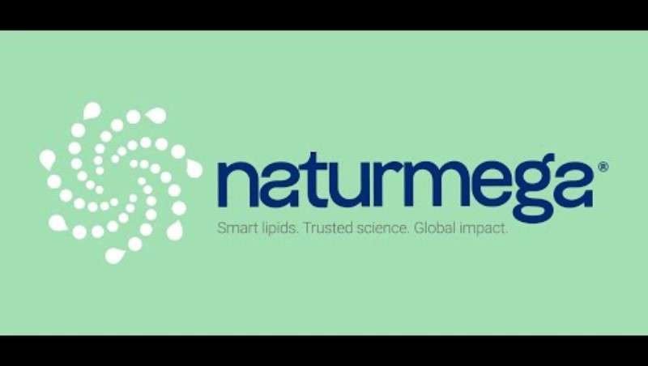
https://youtu.be/OPVhuIBse4c
Notes:
https://youtu.be/OPVhuIBse4c

Slide 4


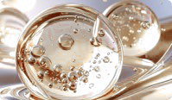

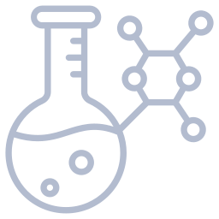
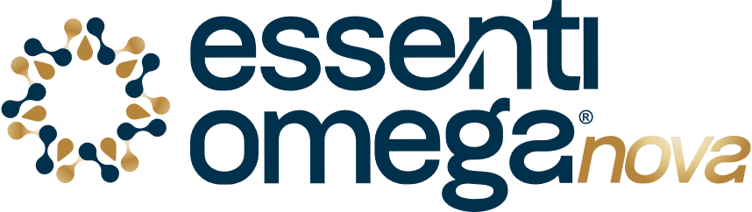



NATURMEGA
A TRUSTED GLOBAL LIPID PARTNER
20+ countries
35+ global clients 140+ employees
Smart Lipids Portfolio
A proven innovation partner, trusted by global brands and long-term regional partners
A structured portfolio of high-performance omega-3 solutions, including concentrates, premium high-DHA algae oils, and patented next-generation delivery platforms.
Our Value Proposal
Trusted by partners across Asia, Europe, and the Americas
Speed with discipline. Flexibility with rigor. Science you can trust. Co-creation at scale
Proprietary Technology
17+
We partner with leading health brands to deliver clinically supported lipid platforms, industrial-scale innovation, and reliable, compliant manufacturing.
Home to Latin America’s first supercritical CO₂ plant and a dedicated Innovation Center, combining molecular distillation and enzymatic biotech to deliver high-purity lipid solutions at scale.
Pioneers in Omega-3 Excellence
Notes:
Naturmega is built on a simple idea: to empower health-forward brands with clinically proven lipid platforms, scalable innovation, and sustainable manufacturing.
We have over 17 years of experience in omega-3 innovation, producing high-purity EPA and DHA ingredients for the nutritional space.
At the core of our expertise is our Innovation Center and Latin America’s first supercritical CO₂ facility, where we combine molecular distillation and enzymatic biotech to develop high-performance lipids like Ruby-O® — our patented phospholipid platform that delivers next-gen absorption and clinical results.
Beyond supplying ingredients, we co-develop customized, clinically supported products — helping brands move from idea to shelf. As mentioned, our portfolio spans medium and high concentrates, high-DHA algae oils, and tailored phospholipid systems.
Our operations are globally certified, sustainably sourced, and supported by a presence in over 30 countries.
And through our partnership with Originates, we bring this lipid science to the U.S. market — combining Naturmega’s innovation and manufacturing capabilities with a distributor that understands the needs of the U.S. supplement market. Originates supports strategic access, commercial rollout, and customer relationships across the omega-3 and advanced lipids category.
ogether, we’re placing special focus on Ruby-O®, our patented phospholipid platform, to help forward-thinking U.S. brands access clinically backed, next-generation omega-3 solutions with commercial support and speed.

Slide 5
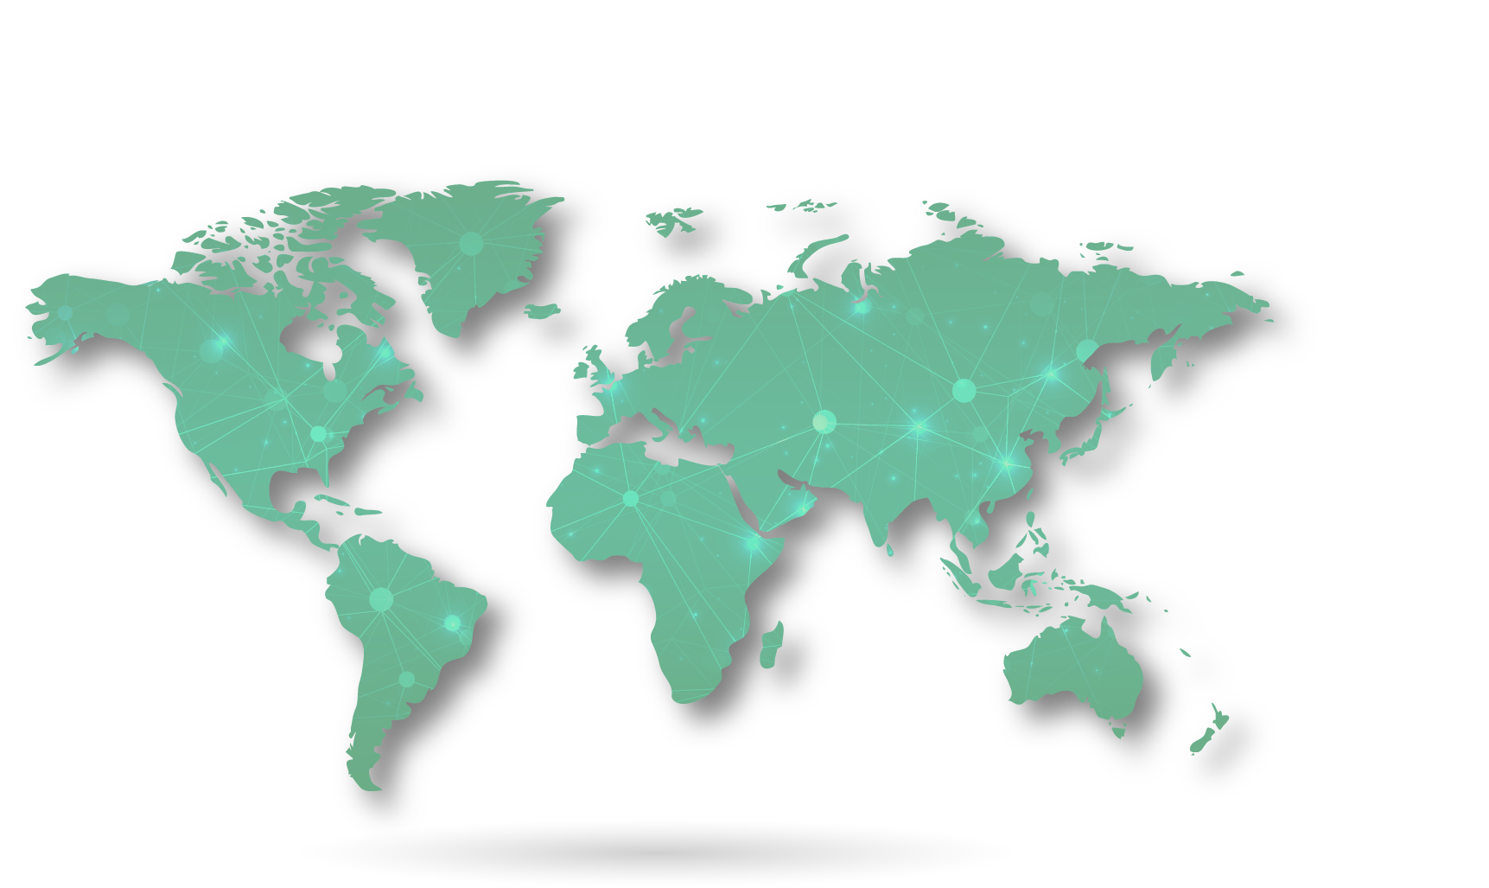
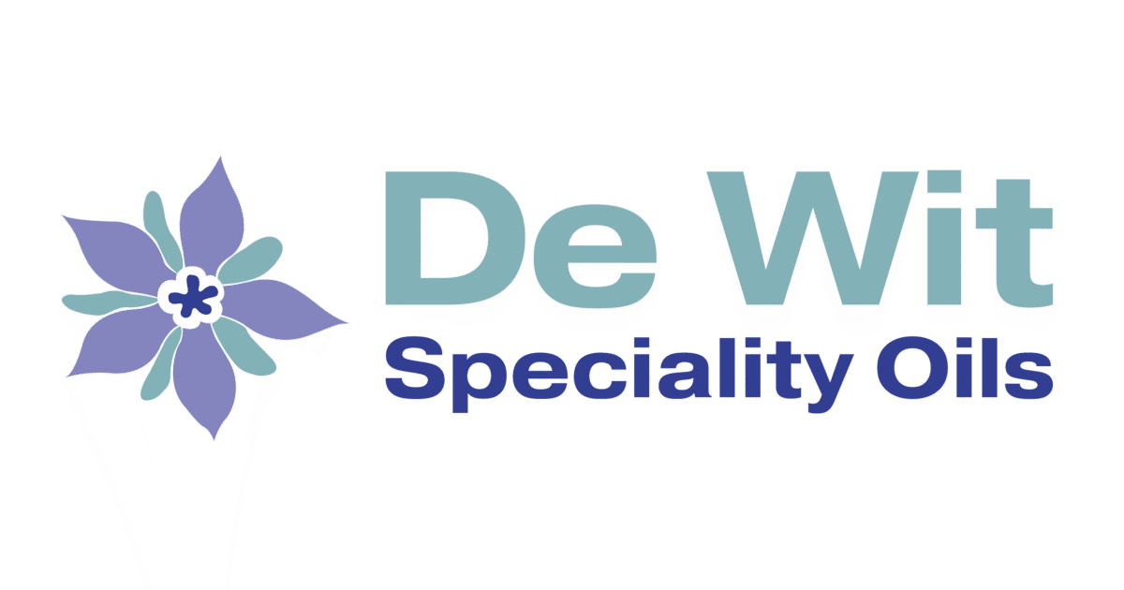

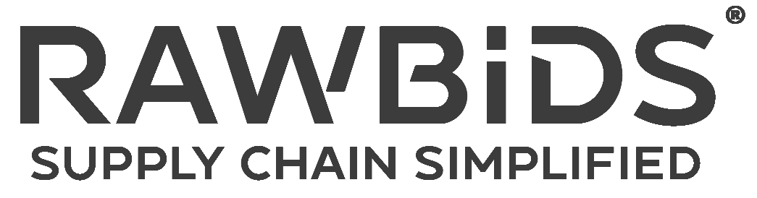



GLOBAL NETWORK TRUSTED PARTNERS
Together with our distributors, we ensure localized support, streamlined access, and consistent quality
—wherever our customers are.
At Naturmega, our reach spans more than 20 countries through a robust network of strategic distribution partners. We work hand in hand with leading companies that share our commitment to quality, science-backed ingredients, and client-focused solutions.
In the United States, we proudly partner with Originates, a specialized distributor with deep category expertise and a shared vision for science-driven, differentiated innovation.
In Europe, we’ve built long-standing partnerships with two key players:
De Wit Speciality Oils (Netherlands) represents our premium oils portfolio, supporting clients with deep market knowledge and a legacy of trust and quality
RAWBIDS (Germany) is our exclusive distributor for Ruby-O®, bringing our next-generation omega platform to visionary brands across the region.
Our Asia-Pacific footprint is expanding through a dedicated partner who support our mission to advance global health with flexible, sustainable omega-3 and lipid solutions.
Distributors
Our product’s presence

Slide 6
Technology Expansion
& Portfolio

Slide 7
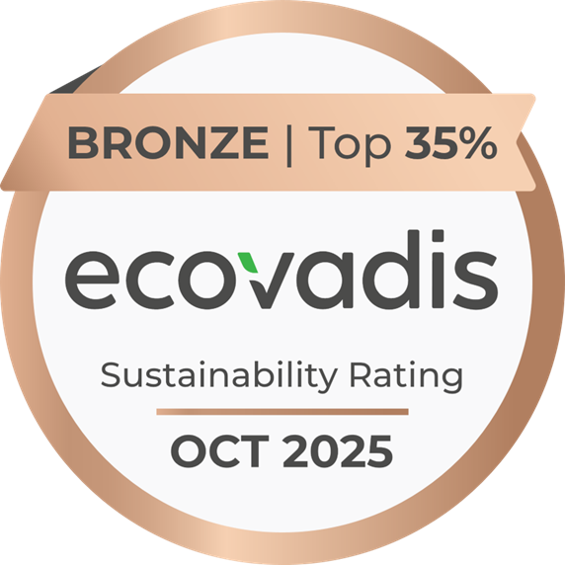



BUILT FOR THE FUTURE
At Naturmega, sustainability is not a side initiative, it’s a core pillar of how we innovate, operate, and grow. From our lipid technologies to our community partnerships, we take a holistic approach that balances environmental responsibility, scientific advancement, and social impact.
We believe the future of health must also be the future of the planet.
OUR COMMITMENT TO SUSTAINABILITY INCLUDES:
Carbon reduction initiatives, including circular use of solvents and future biodiesel generation.
17 years of community programs, focused on environmental education and local well-being in the communities that surround us.
Sustainability integrated across teams, not treated as a separate function.
Low-impact technology, with enzymatic processes reducing emissions by up to 65%.
Responsible sourcing of algae and wild-caught fish oils from certified sustainable practices.
EcoVadis-certified operations, continuously improving our environmental performance.
Notes:
Sustainability isn’t just a checklist for us, it’s embedded in how we think, operate, and innovate.
At Naturmega, we use enzymatic technologies that significantly lower emissions, and we source our marine and algae lipids responsibly from certified, traceable partners.
But our commitment goes beyond the environment. For more than 17 years, we’ve supported education and well-being in the communities that surround us, because we believe long-term impact starts locally.
We’re proud to be EcoVadis-certified, and we continue to push for circular practices, like future biodiesel generation and closed-loop solvent systems.
For us, sustainability is not a separate department, it’s part of every decision we make, from the molecule to the marketplace. Its important to point this out.

Slide 8


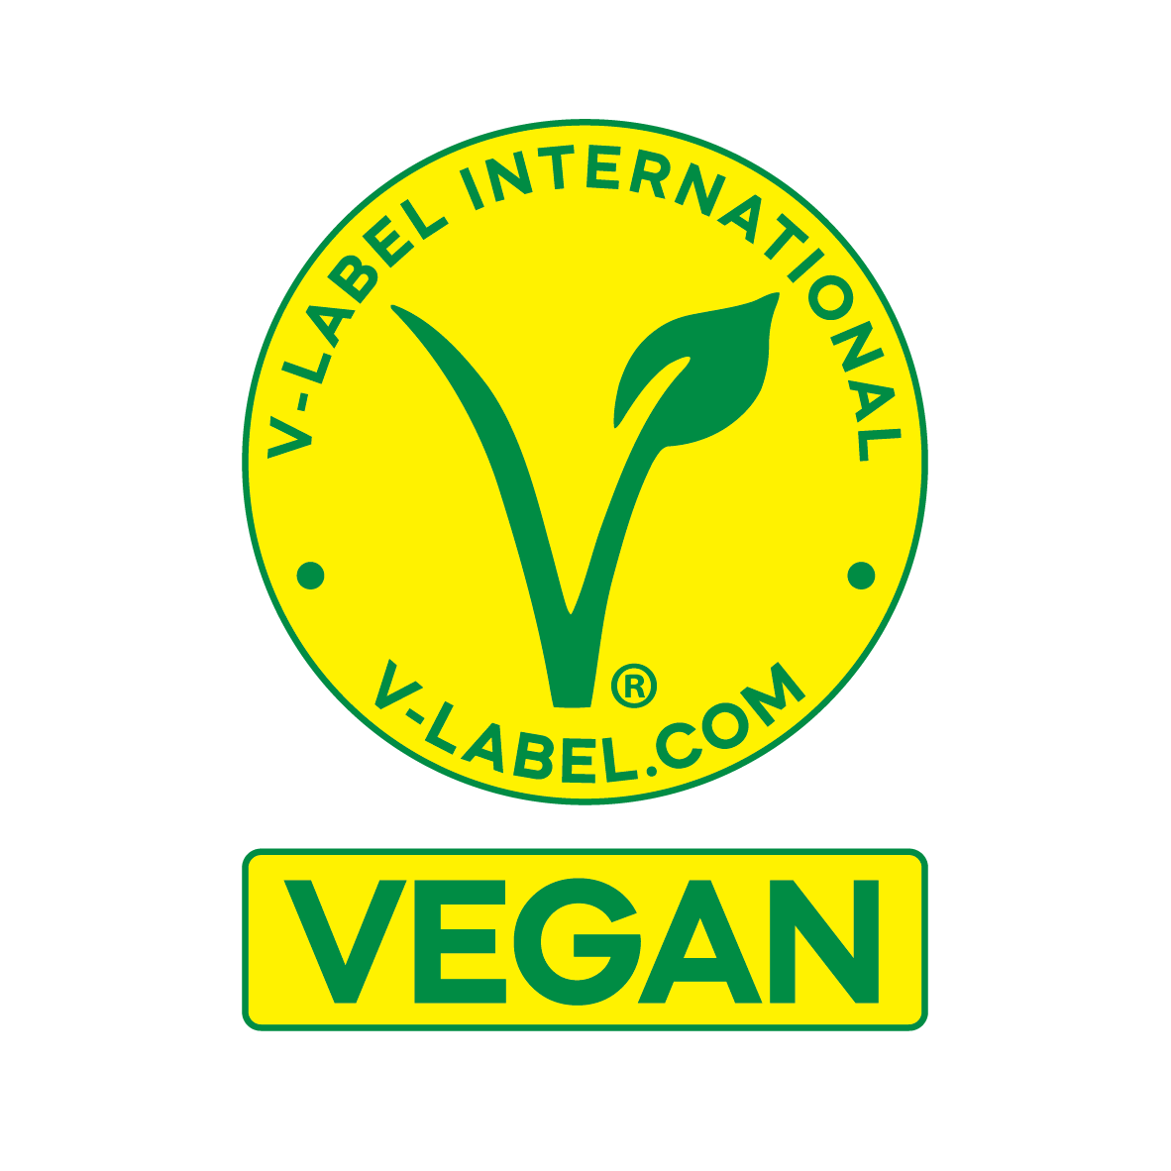
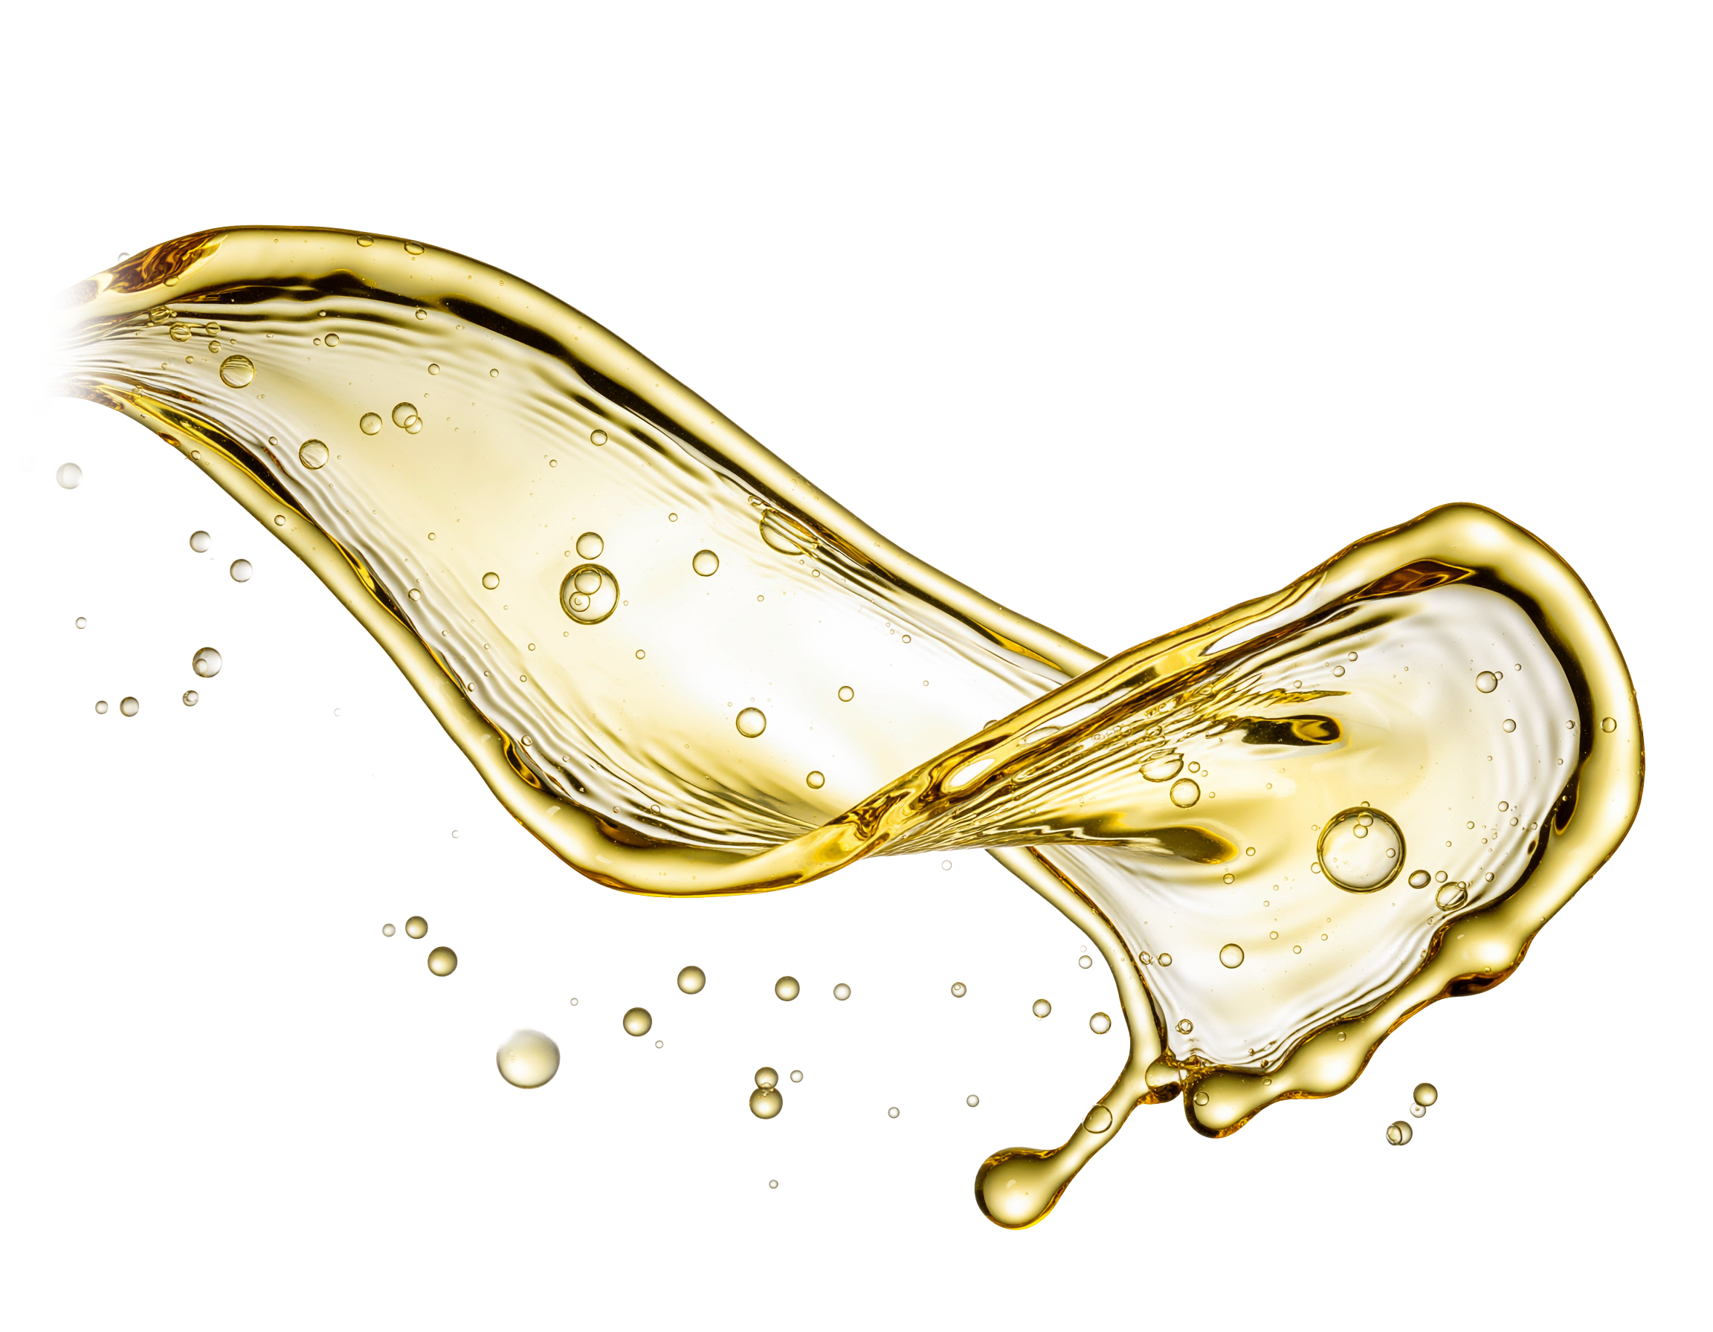
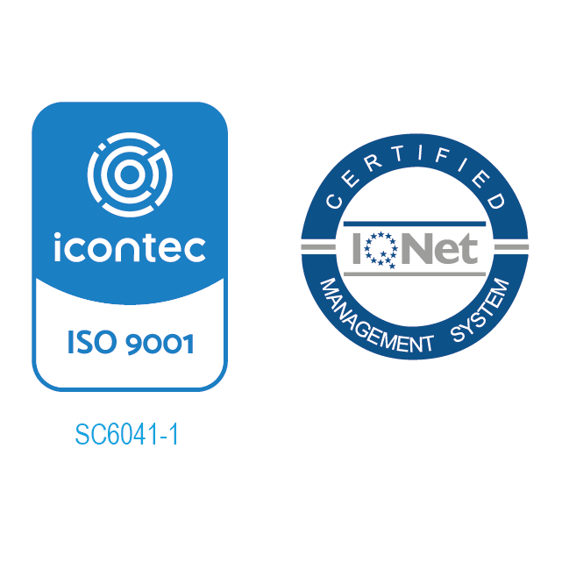

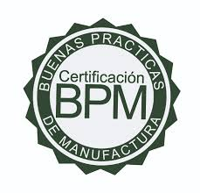

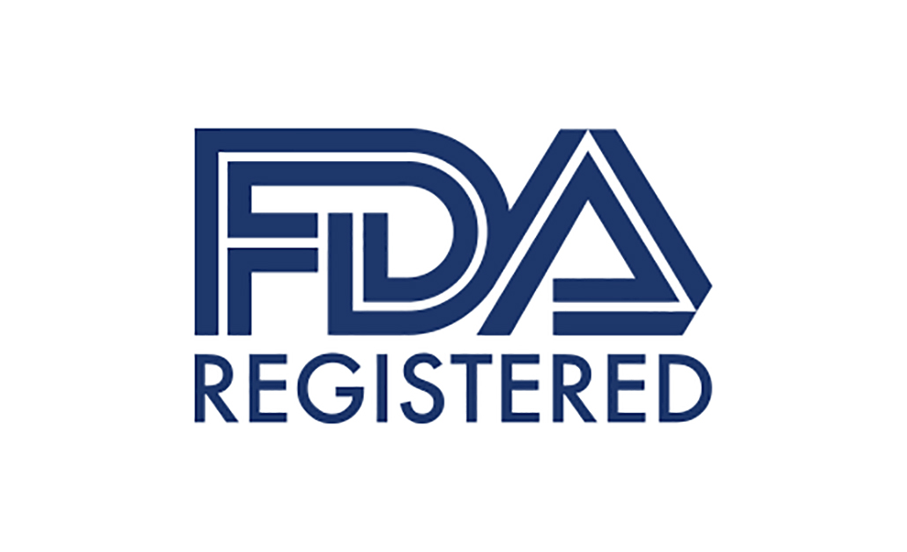
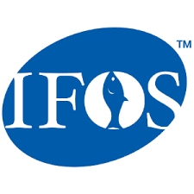
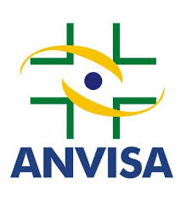
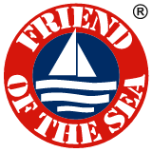
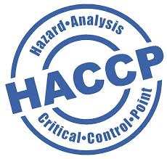


UNPARALLELED
QUALITY
MEMBERSHIPS
INTERNATIONAL STANDARDS
QUALITY
RELIGIOUS
Quality Without Compromise: Standards That Go Beyond Certification.
LABORATORY RECOGNITIONS
ESG
GMP
Independent testing, traceable.
Industry certifications
Meeting and exceeding the most rigorous standards.
REGISTERED FACILITY
SUPPLY CHAIN SAFETY

Slide 9

Built on Trust. Validated by Independent Standards
EcoVadis Sustainability Rating: Bronze (Top 35%)
Naturmega is independently evaluated by EcoVadis, a globally recognized platform assessing corporate responsibility across environment, labor and human rights, ethics, and sustainable procurement.
Our Bronze medal places Naturmega among the top 35% of companies assessed worldwide, reflecting continuous improvement and a strong commitment to responsible operations.

Slide 10


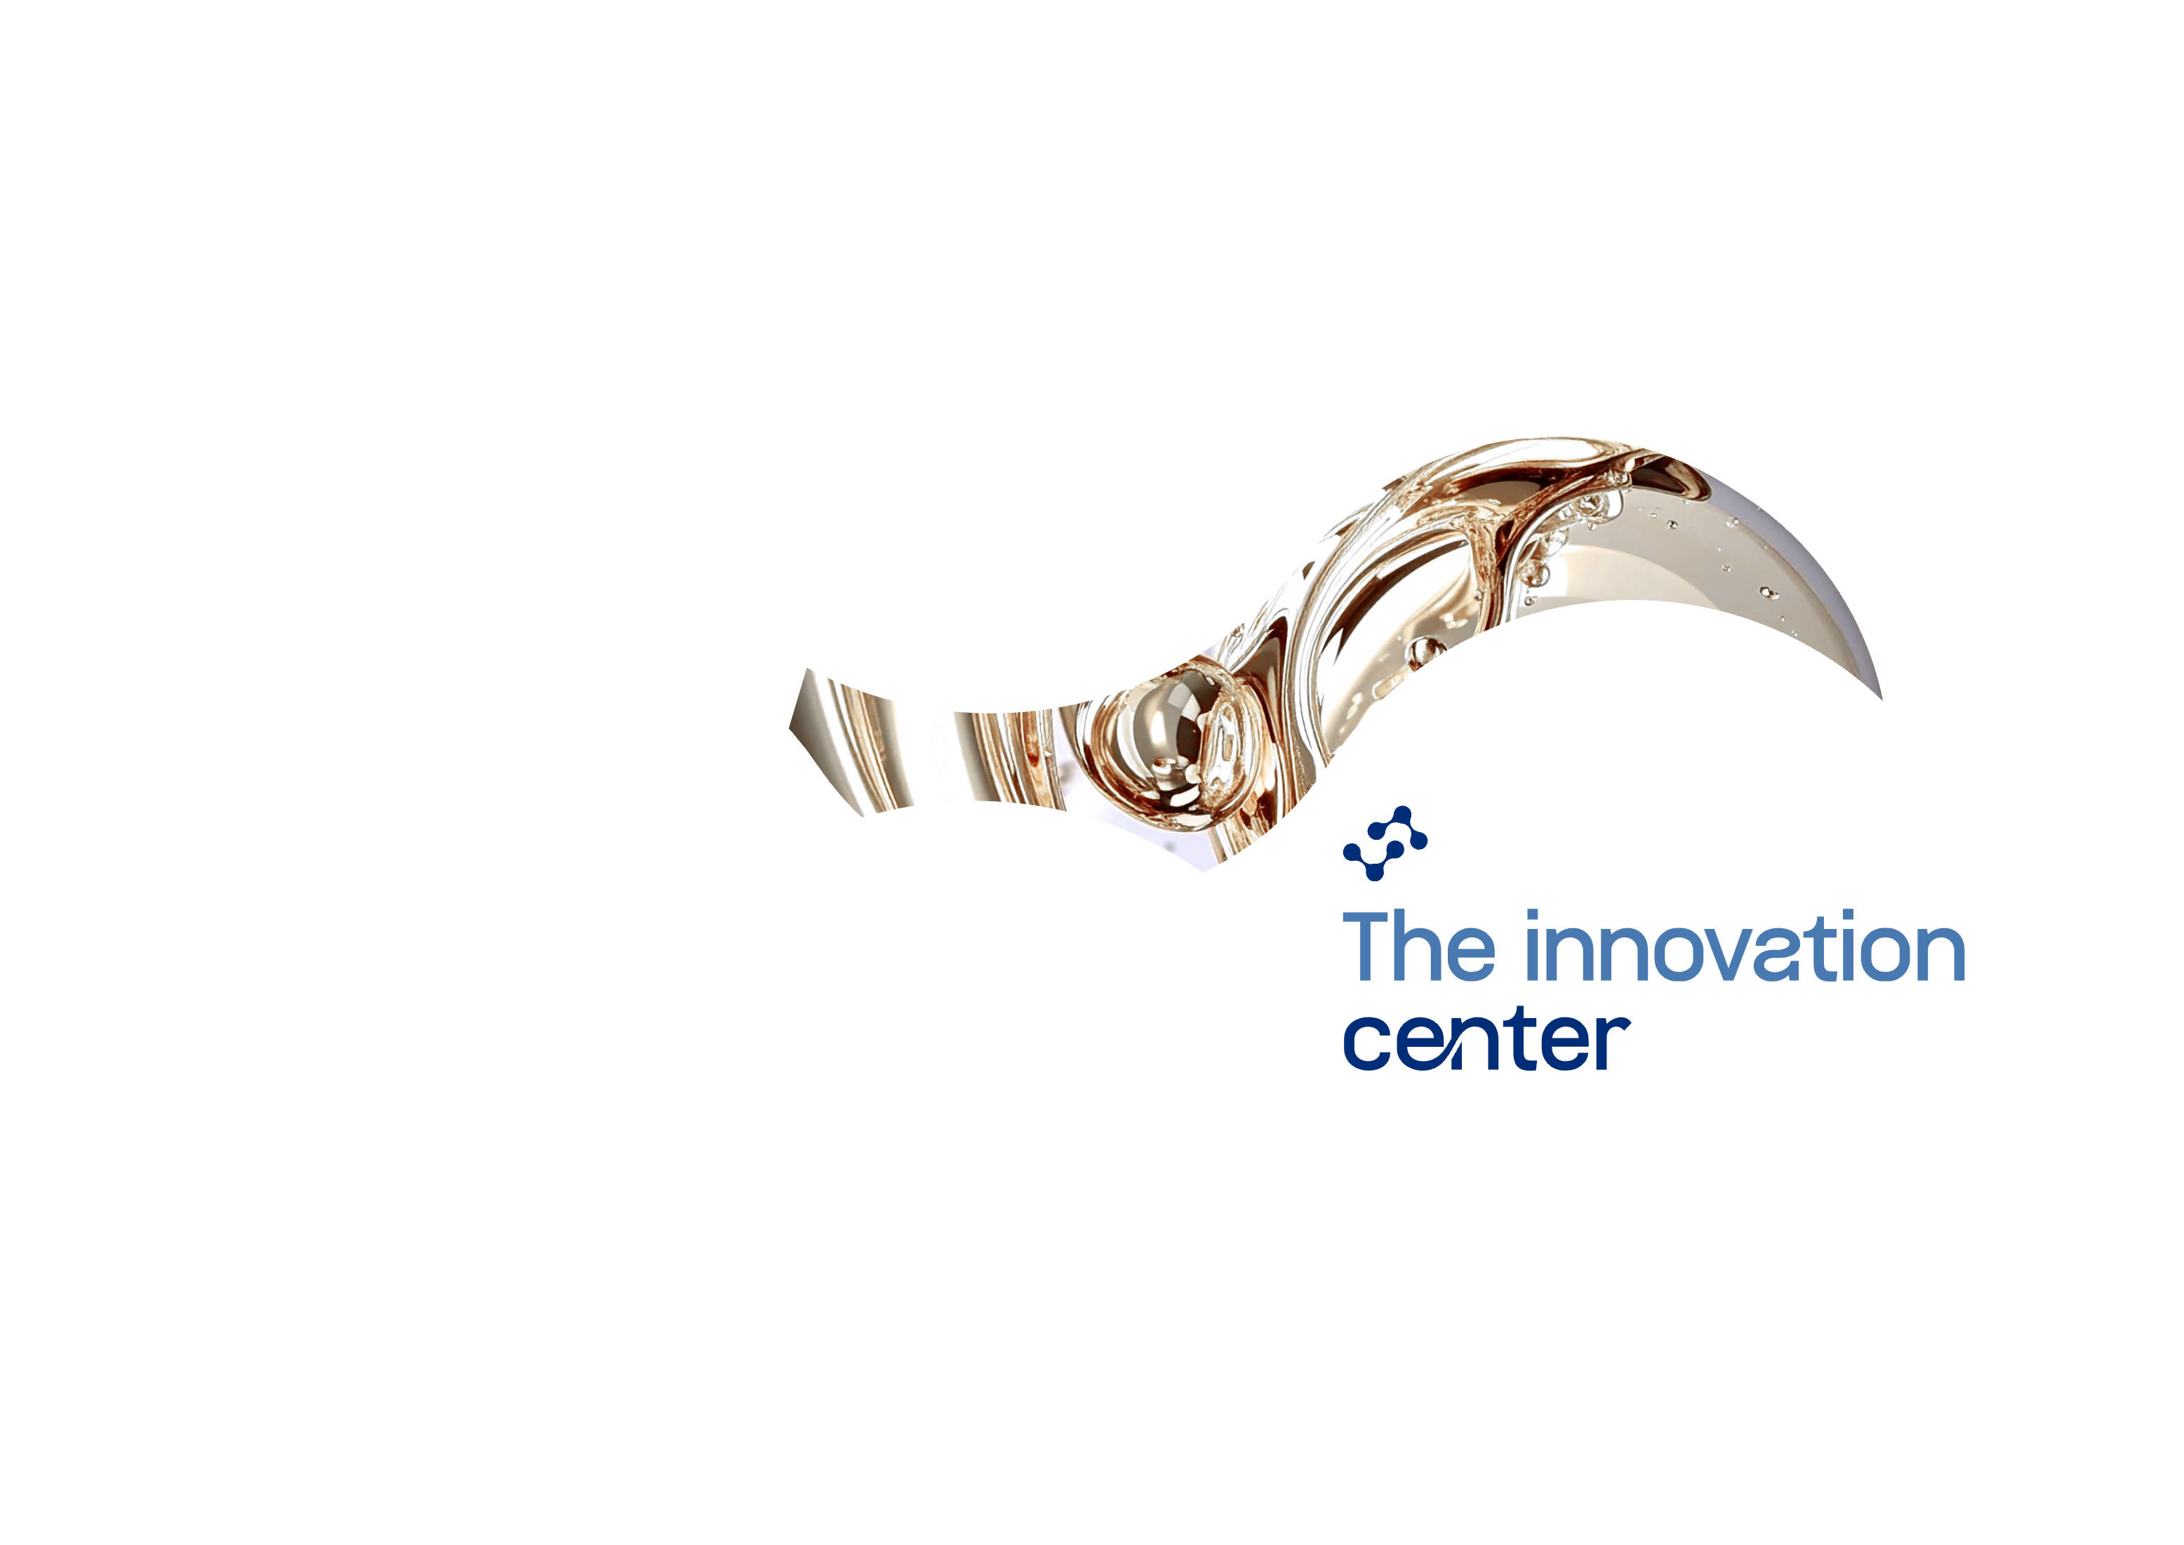



INNOVATION CENTER:
From Molecule to Market
An integrated R&D and pilot-scale platform driving advanced lipid development, formulation, clinical support, and market intelligence.
Enzymatic Biotech
Molecular Distillation
Supercritical Fluid fractionation CO2
Specialized Lipid Systems
Pilot & Prototyping Capabilities
Advanced Science & Technology
Scalable Technologies (Pilot Plant)
Application Formats: Softgels, Gummies, Powders, Emulsions
Strategic Insight & Collaboration
Market Intelligence + Trends
Medical and Scientific Advisory Teams
Co-creation with Clients and CROs
Notes:
Innovation at Naturmega is more than a mindset — it’s built into our infrastructure.
Our Innovation Center serves as an integrated R&D and pilot-scale hub where science meets execution. It brings together advanced lipid technologies — including enzymatic bioconversion, molecular distillation, and supercritical CO₂ — to develop and scale next-generation lipid-based solutions.
But it’s not just about what we make — it’s how we collaborate. The Center enables true co-creation with partners through prototype development, custom delivery formats, and clinically relevant formulations enhanced by our patented Ruby-O® platform.
Supported by a network of CROs, scientific advisors, and universities, and fueled by real-time market intelligence, we help brands translate innovation into launch-ready products with scientific credibility and commercial agility.
For companies looking to lead in heart health, cognition, women’s wellness, or performance nutrition — this is where breakthrough ideas become real.

Slide 11

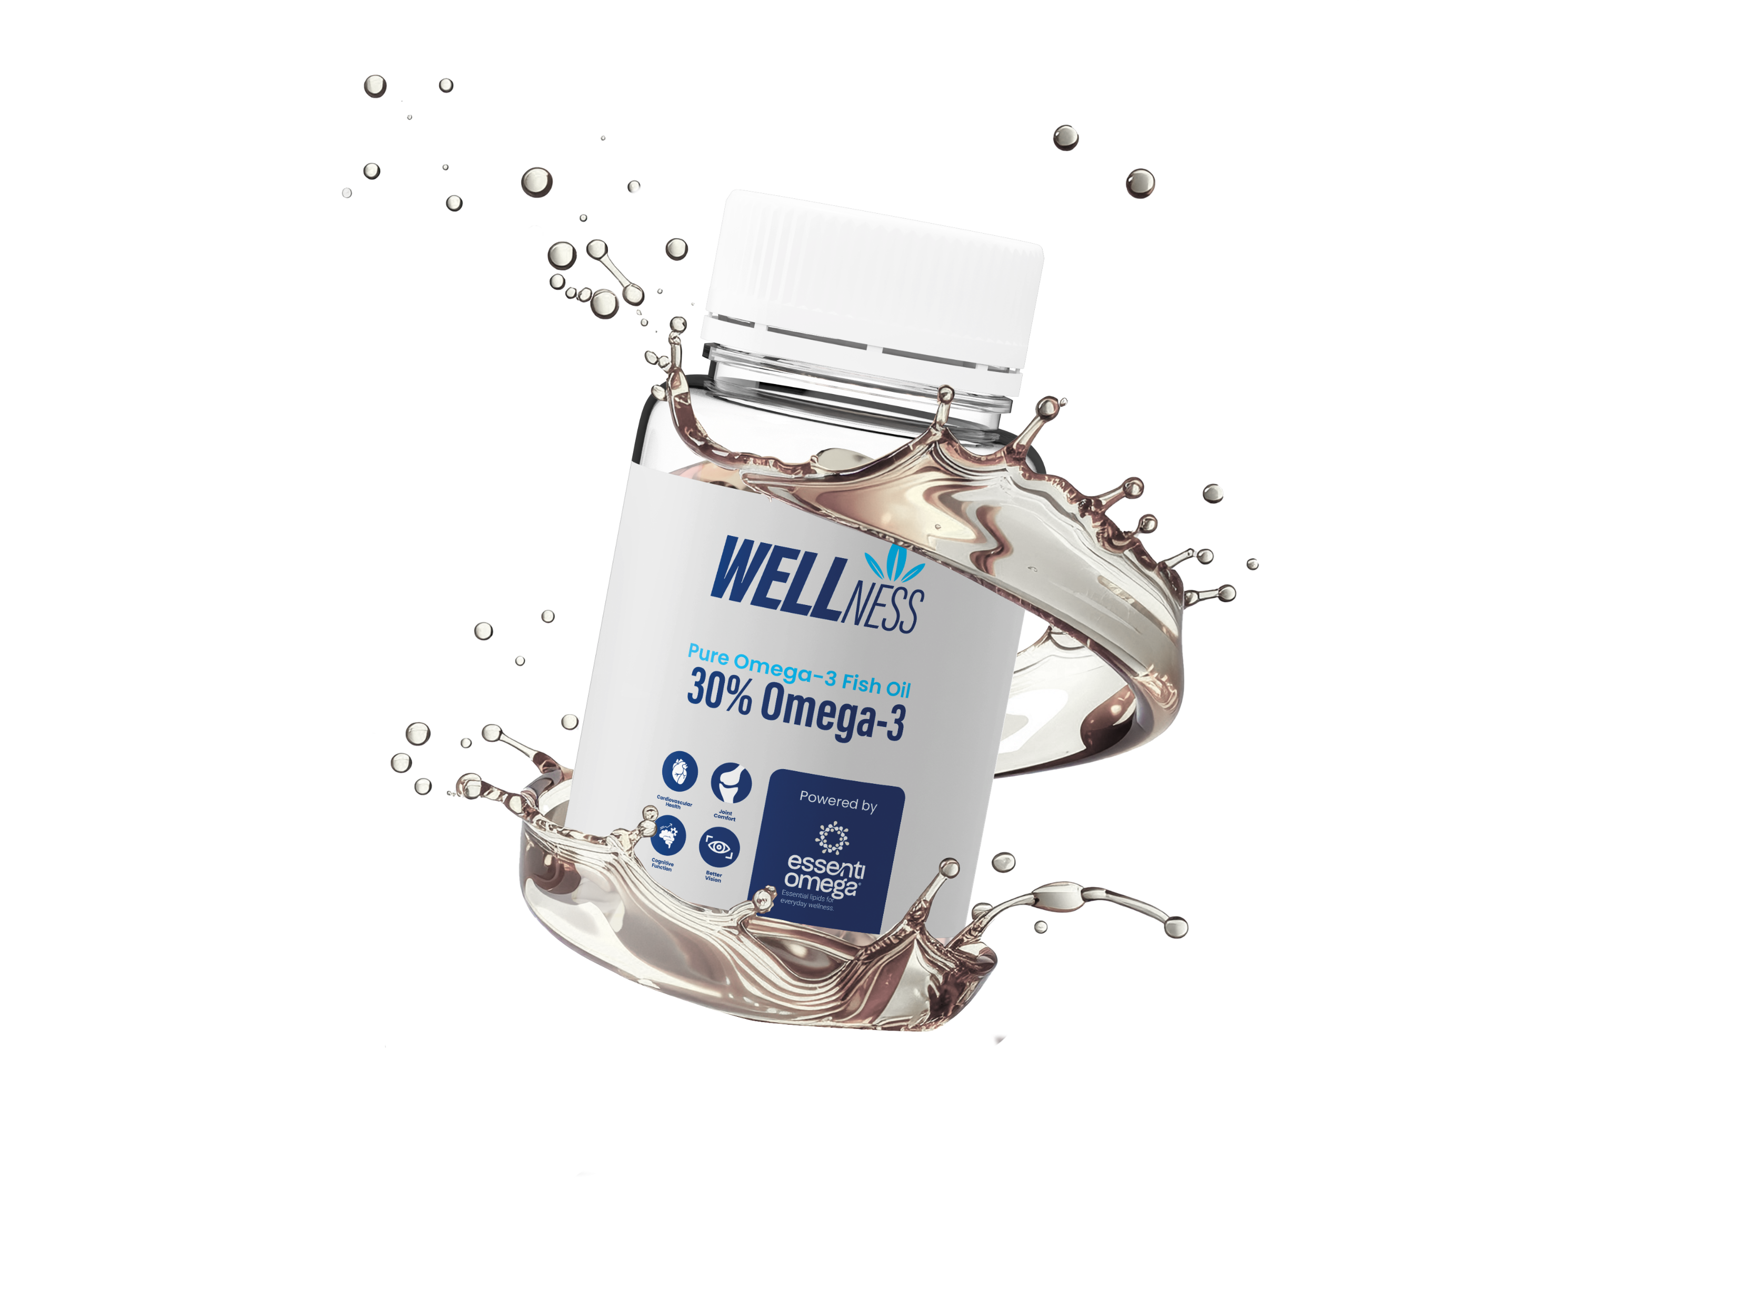
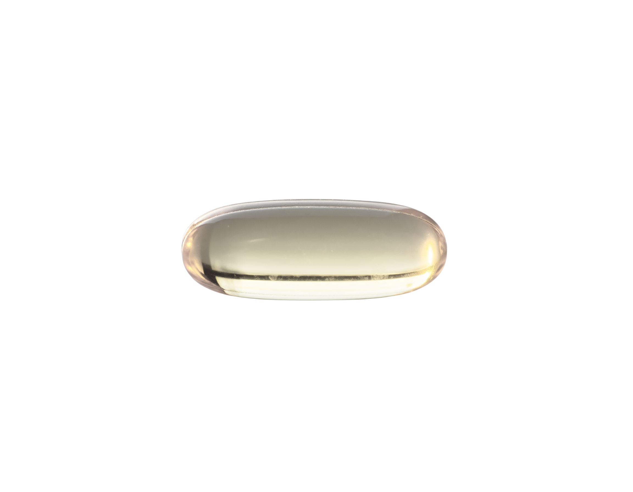
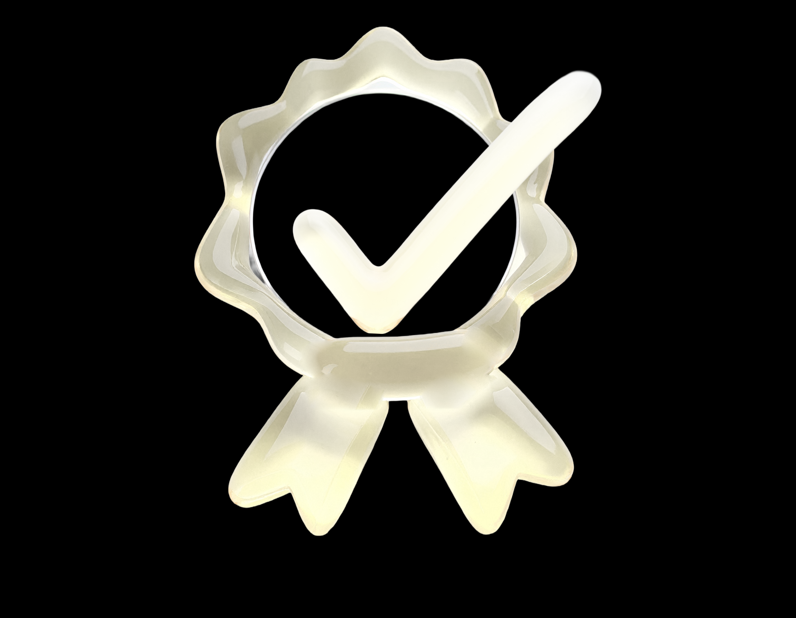

Our Co-Creation Framework:
From Insight To Market
Market Intelligence + Trend Mapping
Global category trends, consumer insights, regulatory updates, crude oil sourcing, pricing dynamics, and seasonal catch forecasts that guide opportunity identification.
Our Co-Creation Framework:
From Insight to Market
Ideation Workshops with Clients
Collaborative innovation sessions and formulation brainstorming to define winning concepts aligned with brand goals and market needs.
A collaborative, science-driven process that transforms insights into differentiated lipid solutions.
Pilot Development + Prototyping
Rapid prototyping across softgels, gummies, emulsions, algae oils, and high-concentrate systems, supported by our Naturmega Senses Panel™ that evaluates taste, smell, texture, and finished product quality.
Scale-Up + Launch Support
Stability data, QC processes, certifications, and claims support to ensure a smooth transition into commercial manufacturing and market launch.
Notes:
At Naturmega, we go far beyond supplying oil — we’re true innovation partners.
Through our R&D and pilot capabilities, we co-develop differentiated, health-forward products — from early concept to scalable, market-ready solutions. Whether you're building a new omega-3 line or enhancing an existing formula, we bring technical expertise, speed, and flexibility to the table.
Our supply chains are traceable, certified, and responsibly sourced — from wild-caught fish to high-DHA algae — ensuring both performance and sustainability.
We support applied science and clinical development to strengthen health claims and position our partners as leaders in evidence-based products.
Our work spans key health territories where lipids matter most: cardiovascular, brain, women’s health, sports recovery, vision, and more. And our team is skilled in helping brands prototype and launch in the formats consumers demand — from softgels to emulsions, powders, and gummies.
With advanced manufacturing technologies, customizable delivery systems, and a deep understanding of regulatory and category dynamics, we help bring bold new lipid-based innovations to life — faster and smarter.

Slide 12

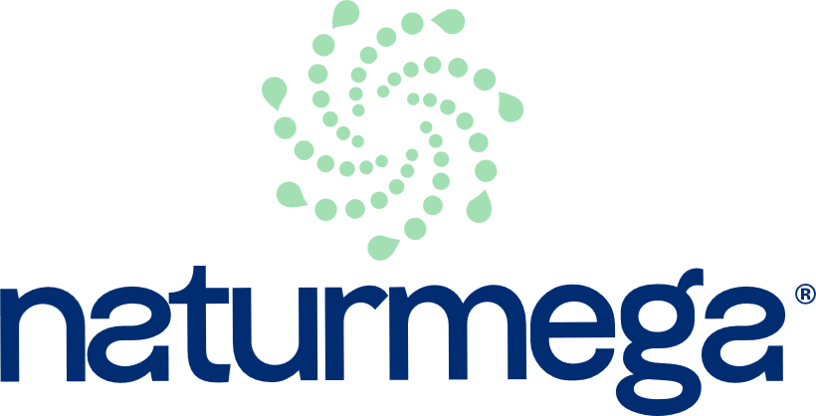
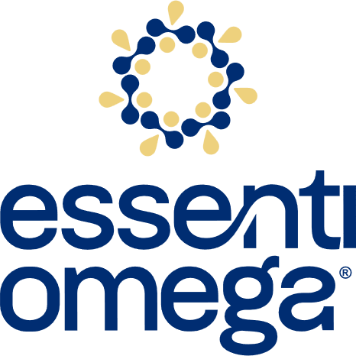
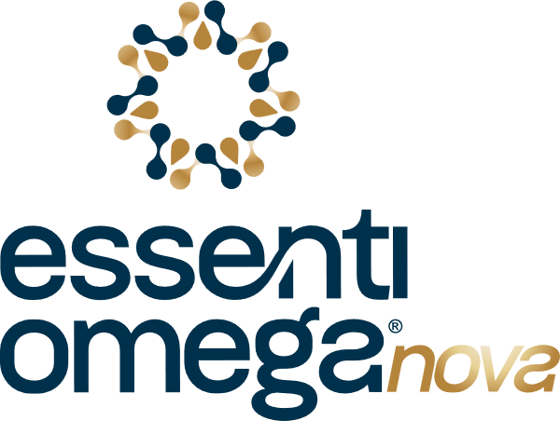
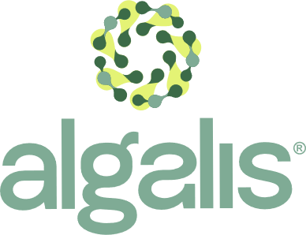

OUR SMART LIPIDS PORTFOLIO
At Naturmega, we offer a wide range of advanced lipid ingredients tailored to your product needs and clinical targets. All available in multiple chemical forms (EE, TG, rTG, FFA).
Clinical-Driven Lipid Innovation
Bonded phospholipid omega-3s designed to work in harmony with human biology.
Foundational Solutions - Medium Concentrates
Ultra-Concentrated Omega-3, Engineered for Sensory Performance
Plant-Based Innovations - Refined Algae DHA Oils
EPA + DHA: 50% to 70%
Available in any ratio and format (EE, TG, FFA)
Powered by Senses™
Designed to address taste, smell, and consumer compliance, without compromising potency.
EPA + DHA: 70–80% ultra-concentrates
Available today in EE format, optimized for sensory performance
Next generation TG format in development, maintaining the same purity and sensory focus
Produced using supercritical CO₂ fractionation for exceptional purity and consistency
TG form
Ideal for plant-based and vegan formulations
DHA: 60% to 80%
rTG form
Supercritical CO₂ extraction for superior purity
Patented Bonded Phospholipid Lipid (BPL-O3™) platform
Clinically supported enhanced absorption and cellular delivery
Designed for high-performance, differentiated formulations
A versatile platform to enable multiple health applications
Notes:
Meterle un tagline en español como orientado al beneficio directo.

Slide 13



EssentiOmega Nova™ Senses
– The New Standard in Ethyl Ester Purity
A next-generation EE fish oil engineered for exceptional sensory quality — cleaner color, superior odor profile, and enhanced oxidative stability.
Designed for CDMOs and premium brands that require outstanding clarity, purity, and consistency in softgel manufacturing.
Key Sensory Attributes
Technology & Differentiators
Color: exceptionally clear appearance for high-quality softgels Odor: low-odor profile with reduced volatile compounds Taste: neutral sensory profile suitable for advanced delivery systems Oxidative Stability: optimized parameters for extended shelf life
EssentiOmega Nova™ Senses is produced using Naturmega’s supercritical CO₂ technology, delivering ultra-pure EPA/DHA ethyl esters with refined sensory performance and batch-to-batch consistency.

Slide 14









Introducing Ruby-O®
BPL-03TM Technology— Bonded Phospholipids + Omega 3
It’s a patented molecular platform designed to deliver superior bioavailability, enhanced clinical outcomes, and multi-benefit potential across health categories.
Naturally self-emulsifies for superior bioavailability
Versatile platform for cardiovascular, cognitive, women’s health, and sports applications, co-creation and custom applications.
Transports bioactives directly to target tissues
Unlike conventional omega-3s, Ruby-O® leverages phospholipid bonding to improve absorption and stability, achieving more with less.
Backed by clinical data, it’s redefining what’s possible in omega-3 innovation.
2.74x greater triglyceride reduction than standard fish oil, despite a lower daily EPA+DHA dose
Clinically proven to outperform krill oil in absorption
Notes:
Let me introduce you to Ruby-O®, our patented next-generation bound phospholipid omega-3 platform.
What makes Ruby-O® different is not just the ingredients, but it´s unique structure. It’s a patented platform where EPA, DHA, phospholipids, glycolipids, and naturally occurring choline are enzymatically bound together, not simply blended, so this makes it much more than just a branded ingredient, it’s a complete platform.
This structure enables natural self-emulsification, higher stability, and significantly better absorption.
In our first published clinical trial in 2023, Ruby-O® was shown to deliver 25% higher EPA+DHA peak levels than krill oil, reached peak concentration 2.4 hours faster, and provided 62% more EPA+DHA per capsule, all with excellent tolerability.
We’re now moving into Study #2, which is already showing promising early results, further validating Ruby-O®’s superior bioavailability and metabolic impact: 3x more effective than triglyceride-form omega-3 in reducing TGs in the 150–250 mg/dL subgroup
These results reinforce that the bound structure isn’t just absorbed better — it also drives real metabolic outcomes, especially in cardio-related conditions,
This is more than a delivery system: Ruby-O® actively transports nutrients to target tissues, supporting cardiovascular, cognitive, women’s, prenatal, and active lifestyle health. For brands, this means: better absorption, fewer capsules, clean-label appeal, and a versatile formulation platform across key categories
Bottom line: if you’re looking to stand out in the omega-3 space, Ruby-O® offers a clinically validated, formulation-ready solution, built for absorption and built for today’s wellness consumer.

Slide 15
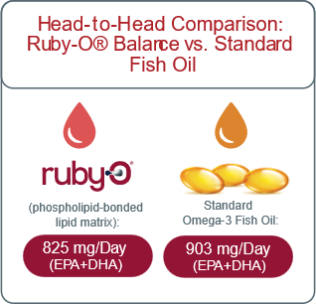


Achieving More with Less: Ruby-O® Demonstrates Efficacy at a Significantly Lower Dose*
Can you deliver real triglyceride reduction with less omega-3 than traditional high-dose products? Ruby-O® took on that challenge, and the results were clear.
KEY FINDINGS:
2.7x greater triglyceride reduction than standard formulations — at a lower dose
More patients reached meaningful results, exiting the high-risk zone
Omega-3 Index improved by 34%, moving closer to the optimal range
Proven to achieve more with less—greater impact, reduced dose.
*This was a 12-week, randomized, double-blind clinical trial involving adults diagnosed with hypertriglyceridemia. Participants were assigned to receive either Ruby-O® Balance or a standard omega-3 supplement, each at a dose of 3 capsules per day. Despite delivering a lower daily EPA+DHA dose (825 mg vs. 903 mg), Ruby-O® demonstrated superior outcomes in triglyceride reduction and Omega-3 Index improvement.
Notes:
Let me introduce you to Ruby-O®, our patented next-generation bound phospholipid omega-3 platform.
What makes Ruby-O® different is not just the ingredients, but it´s unique structure. It’s a patented platform where EPA, DHA, phospholipids, glycolipids, and naturally occurring choline are enzymatically bound together, not simply blended, so this makes it much more than just a branded ingredient, it’s a complete platform.
This structure enables natural self-emulsification, higher stability, and significantly better absorption.
In our first published clinical trial in 2023, Ruby-O® was shown to deliver 25% higher EPA+DHA peak levels than krill oil, reached peak concentration 2.4 hours faster, and provided 62% more EPA+DHA per capsule, all with excellent tolerability.
We’re now moving into Study #2, which is already showing promising early results, further validating Ruby-O®’s superior bioavailability and metabolic impact: 3x more effective than triglyceride-form omega-3 in reducing TGs in the 150–250 mg/dL subgroup
These results reinforce that the bound structure isn’t just absorbed better — it also drives real metabolic outcomes, especially in cardio-related conditions,
This is more than a delivery system: Ruby-O® actively transports nutrients to target tissues, supporting cardiovascular, cognitive, women’s, prenatal, and active lifestyle health. For brands, this means: better absorption, fewer capsules, clean-label appeal, and a versatile formulation platform across key categories
Bottom line: if you’re looking to stand out in the omega-3 space, Ruby-O® offers a clinically validated, formulation-ready solution, built for absorption and built for today’s wellness consumer.

Slide 16



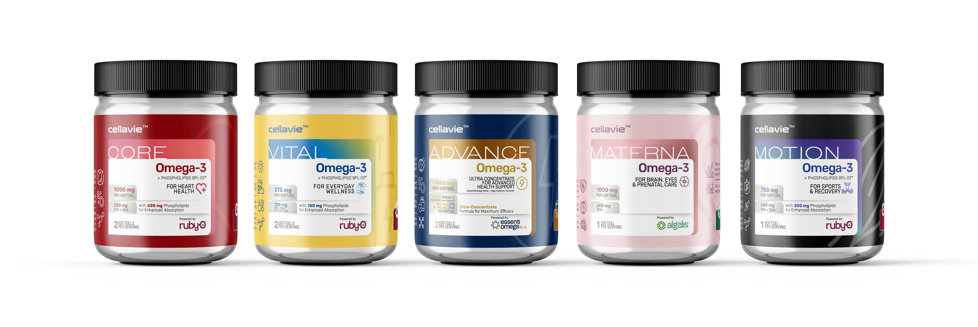
SCIENCE-DRIVEN FORMULATION
Concepts Powered by Ruby-O®
Cellavie™ is our signature concept product line, where we co-create category-ready formulations powered by Ruby-O®. We combine lipid science with synergistic ingredients to deliver next-gen supplements.
Launchable solutions, backed by science, aligned with consumer trends, and customizable for your brand.
With Ruby-O® as your platform, the formulation possibilities are endless.
*This was a 12-week, randomized, double-blind clinical trial involving adults diagnosed with hypertriglyceridemia. Participants were assigned to receive either Ruby-O® Balance or a standard omega-3 supplement, each at a dose of 3 capsules per day. Despite delivering a lower daily EPA+DHA dose (825 mg vs. 903 mg), Ruby-O® demonstrated superior outcomes in triglyceride reduction and Omega-3 Index improvement.
Achieving More with Less: Ruby-O® Demonstrates Efficacy at a Significantly Lower Dose*
Can you deliver real triglyceride reduction with less omega-3 than traditional high-dose products? Ruby-O® took on that challenge, and the results were clear.
KEY FINDINGS:
2.7x greater triglyceride reduction than standard formulations — at a lower dose
More patients reached meaningful results, exiting the high-risk zone
Omega-3 Index improved by 34%, moving closer to the optimal range
Proven to achieve more with less—greater impact, reduced dose.

Slide 17

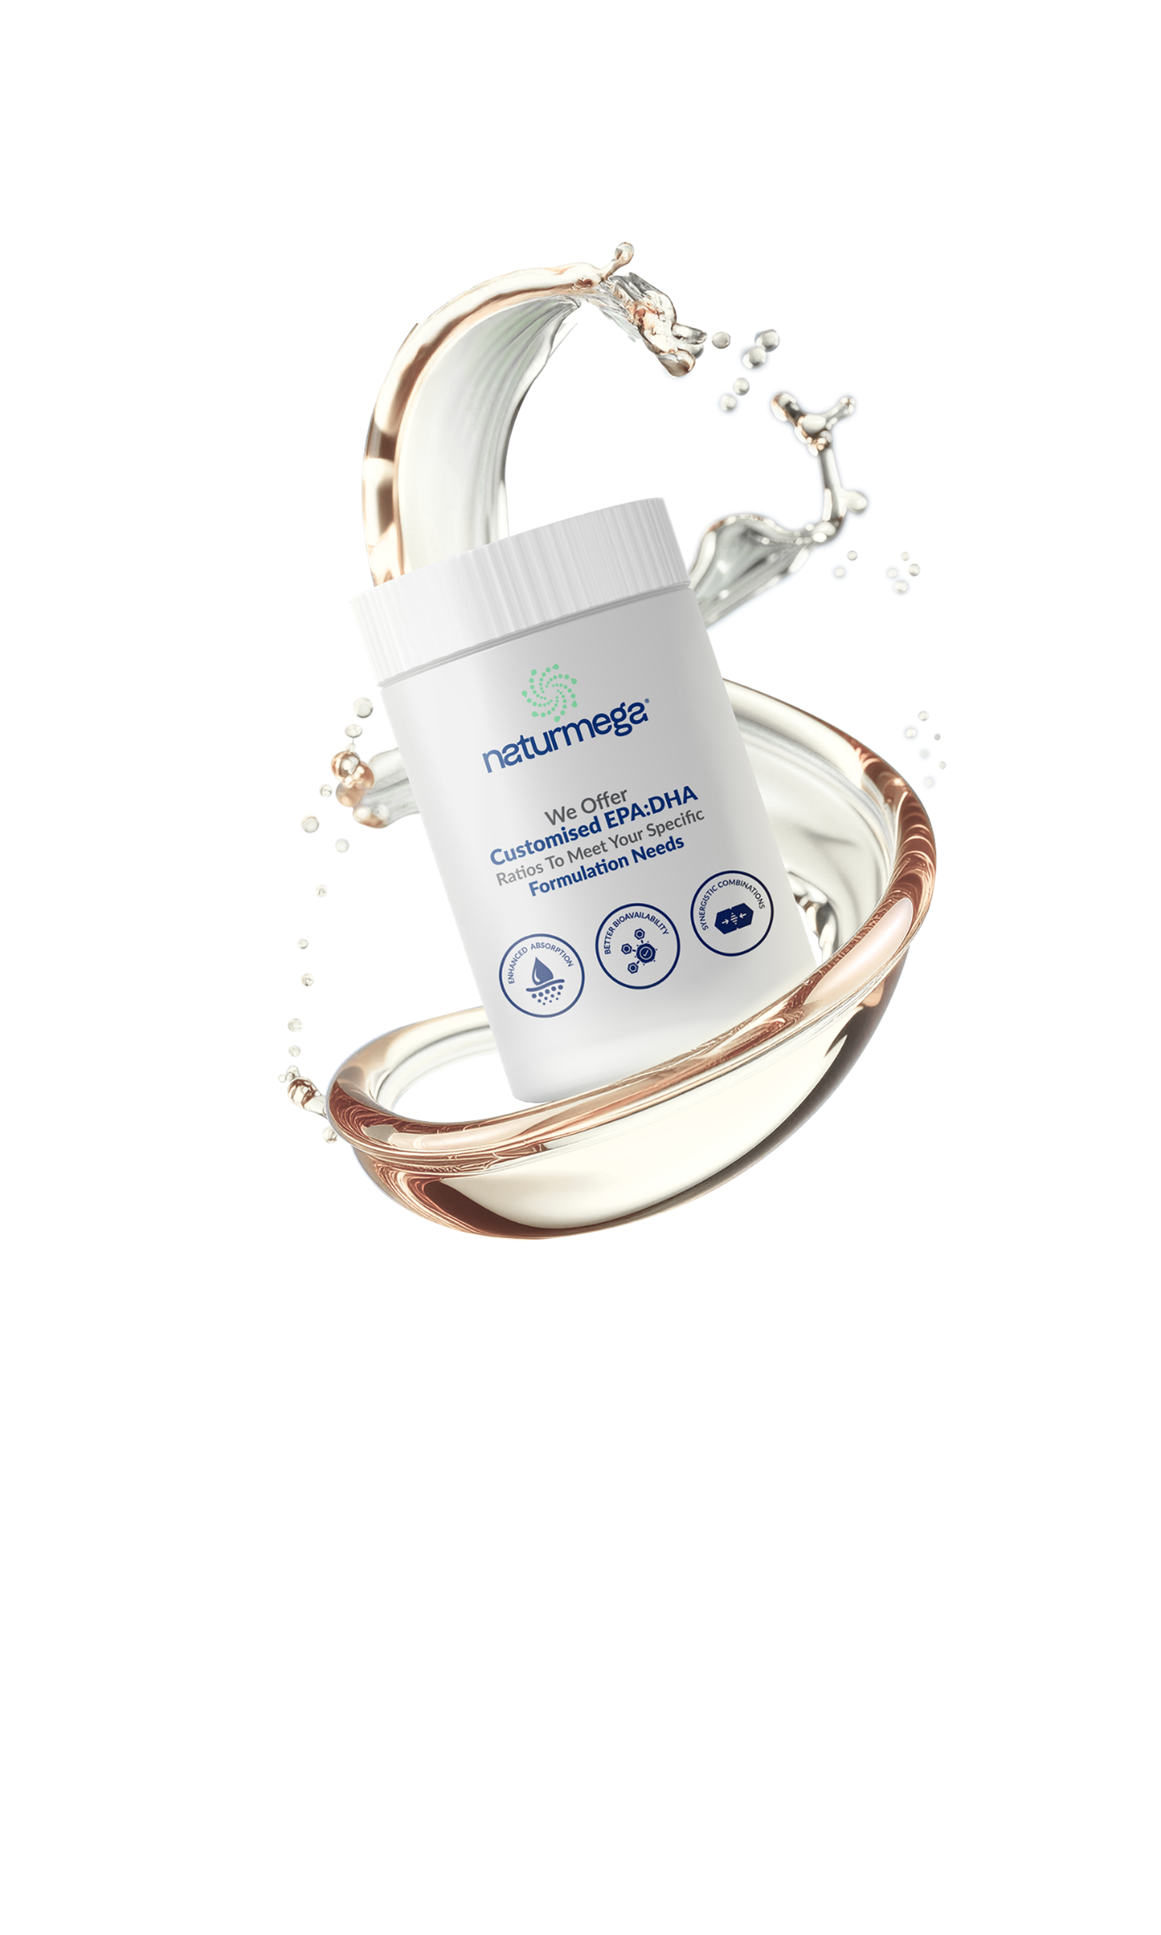

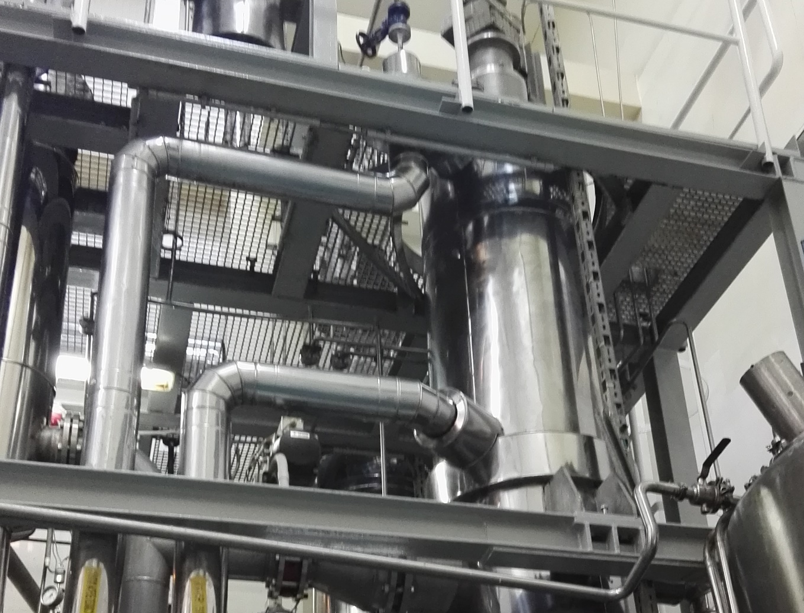
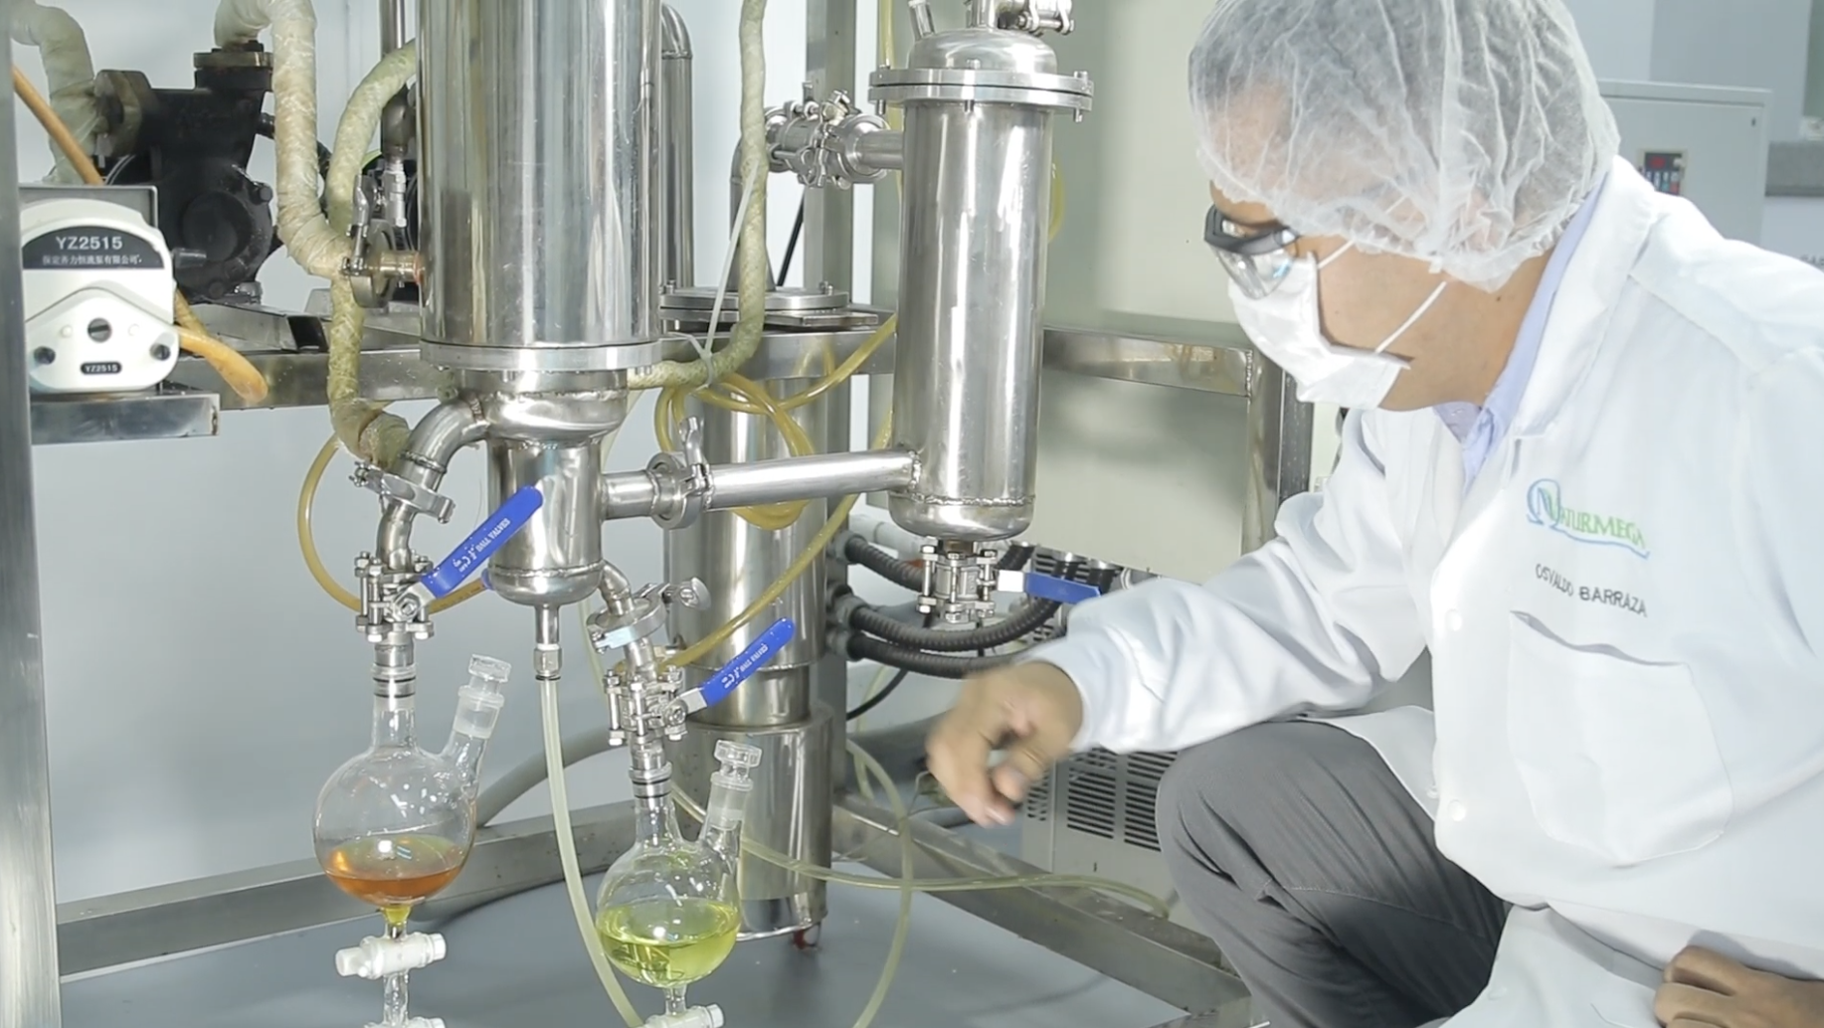
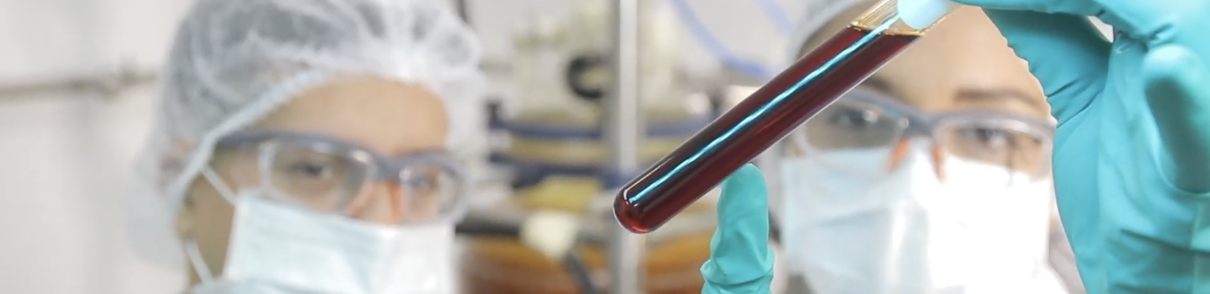
Why Naturmega: A Renewed Partner with Advanced Capabilities for Consistent, Reliable Supply
Industry-leading purity and consistency - New Technologies & Capacity Expansion
Fully modernized processing platform Upgraded automation, refined parameters, and strengthened process controls for greater reliability.
Consistent, High-Quality Supply Chain
Premium oils, strengthened processes, and trusted partnerships (including De Wit) ensure stable, reliable, uninterrupted supply.
Reliable, On-Time Delivery
Agile manufacturing and improved planning enable dependable lead times for global partners.
Scalable capacity for global partners Built to support large volumes and premium formulations with confidence and efficiency.
Future-ready foundation for next-generation lipids Empowers advanced ingredient systems like EssentiOmega Nova Senses™ and Ruby-O®.
Competitive Commercial Conditions
Efficient processes and optimized sourcing allow us to offer strong and flexible pricing structures.
Notes:
Naturmega today operates with a completely upgraded technological platform. Our Supercritical CO₂ facility represents a major step forward for purity, selectivity, and process control, giving us much tighter specifications and superior consistency across batches.
Alongside this, we have modernized our production infrastructure, enhanced automation, and strengthened our internal quality architecture. This allows us to offer our partners a more robust, more predictable, and more scalable supply of high-performance lipids.
These advancements are also what enable next-generation innovations like EssentiOmega Nova Senses and Ruby-O — technologies that simply wouldn’t be possible without this renewed foundation.
For partners like OurVita, this means a stronger, more reliable Naturmega, fully prepared to support long-term growth and premium product development.

Slide 18




Contact us
contacto@naturmega.com
www.naturmega.com
@naturmega

